Slide 1

WAY TO ENTERPRISE
AWS
VTI ACADEMY
Author: duy.nguyenngoc1@vti.com.vn

Slide 2
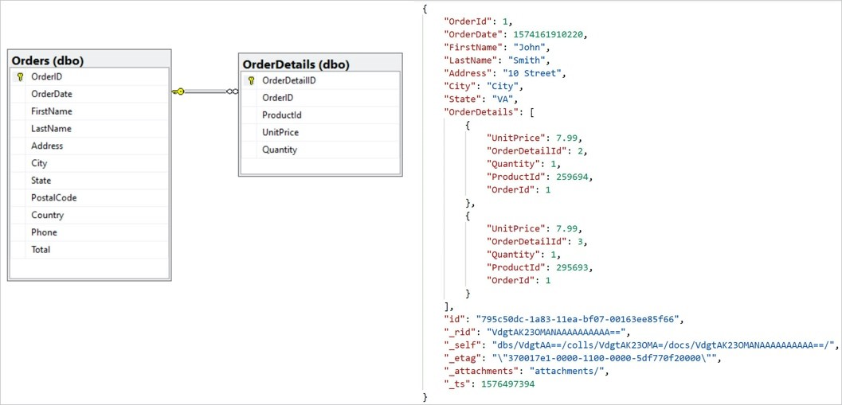
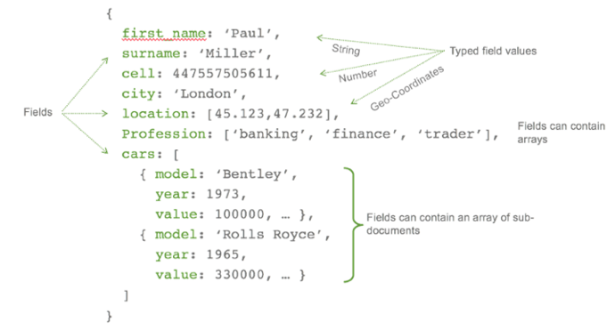
SQL & NoSQL
Collection - Table
Document - Row
Key - Field

Slide 3
DynamoDB Service
Is a NoSQL database (similar to MongoDB), a proprietary technology from AWS (not open sourced)
Slower than MongoDB, the DynamoDB community is also smaller, DynamoDB for using AWS
Fast & flexiable, storing data in SSD
Millions of requests per seconds, trillions of row, hundreds of TB for storage
Auto scaling based on massive workloads, distributed database
Integrated with IAM for security, authorization and administration
https://docs.aws.amazon.com/amazondynamodb/latest/developerguide/Introduction.html

Slide 4
DynamoDB Service
Usecase: e-commerce application, storing session state
Regional service
Price: https://aws.amazon.com/dynamodb/pricing

Slide 5
DynamoDB Service
Demo
Create table
Create item
View item
Update item
Query the Partition Key & Sort Key
Create Global Secondary Index
Query the Global Secondary Index

Slide 6
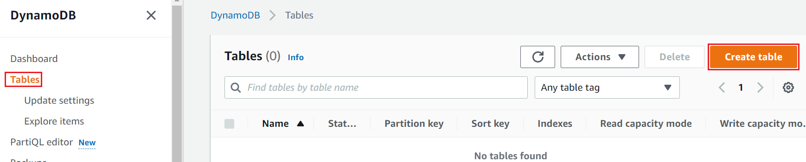
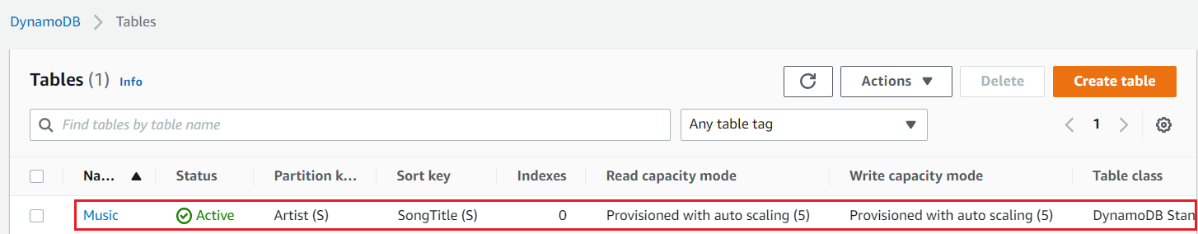
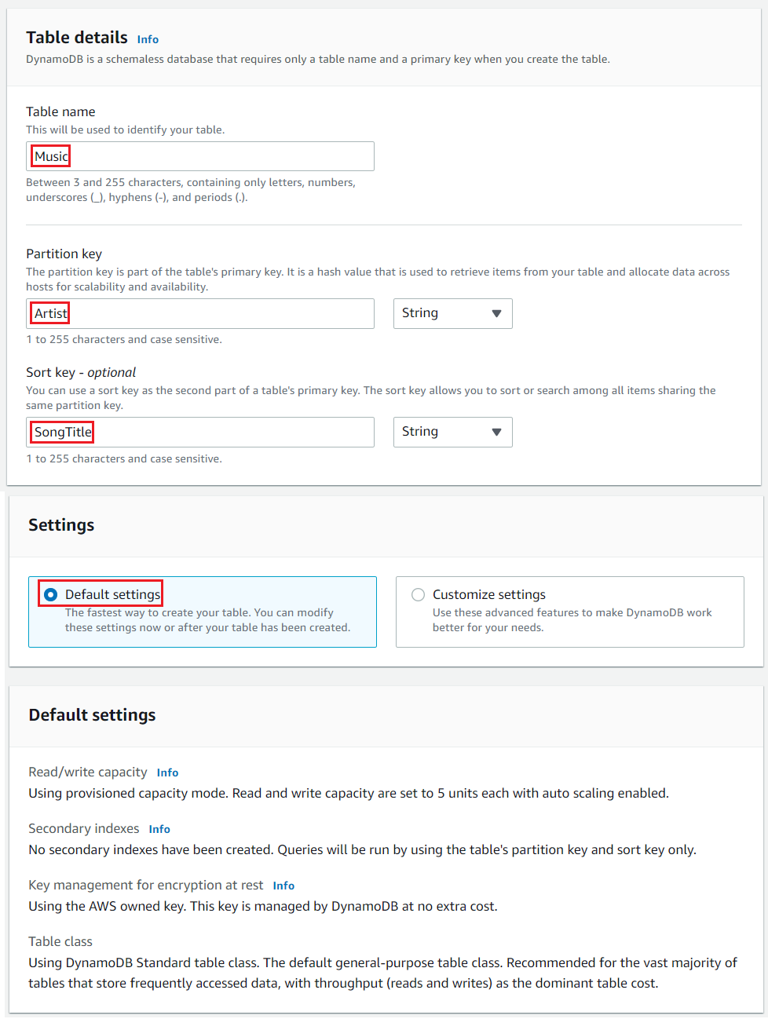
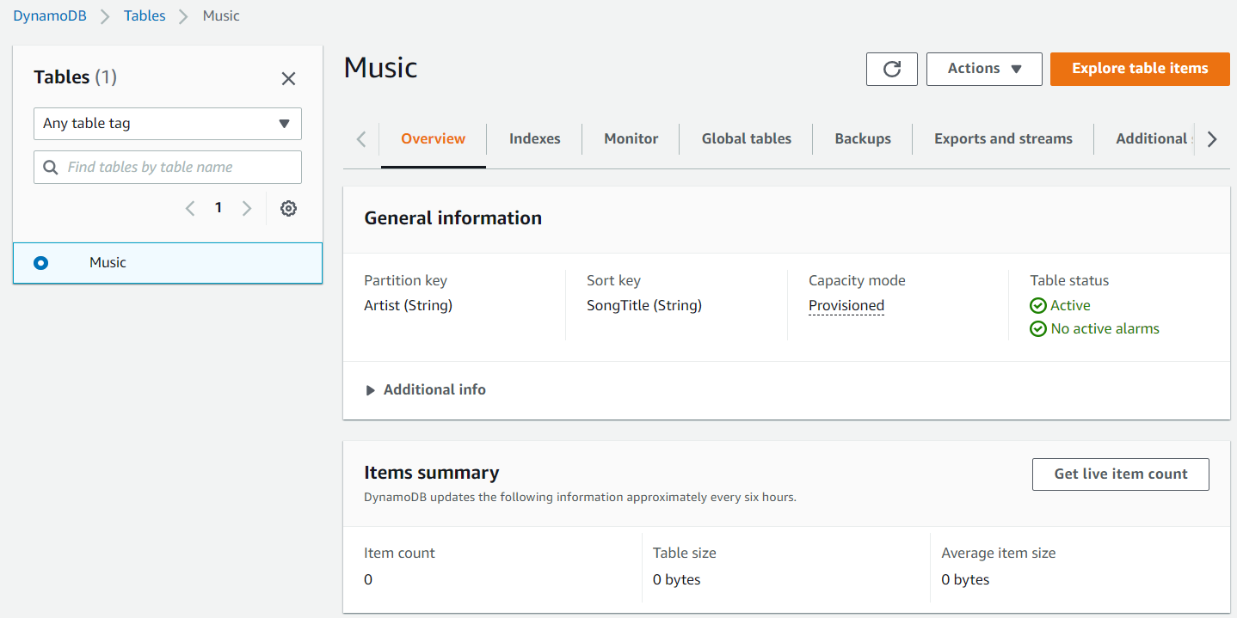
DynamoDB Service
Create table

Slide 7
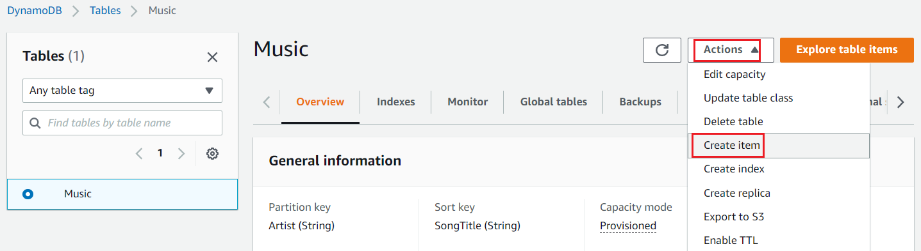
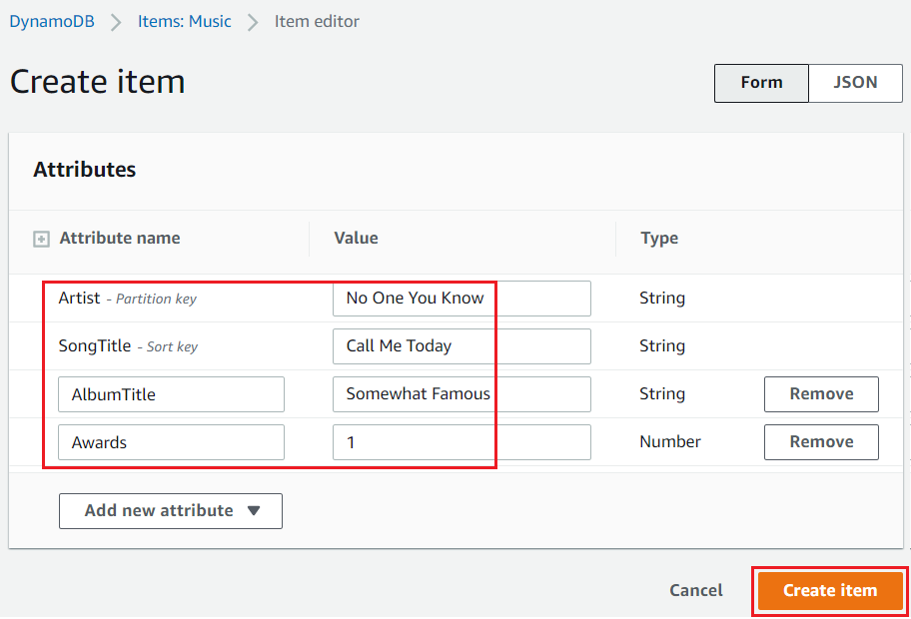
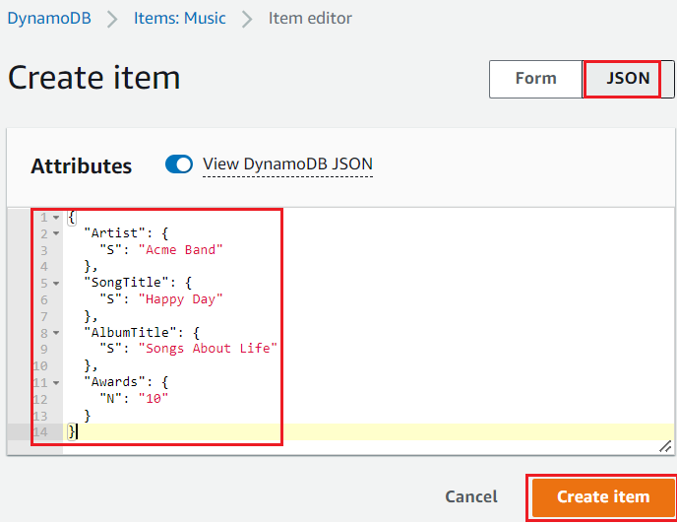
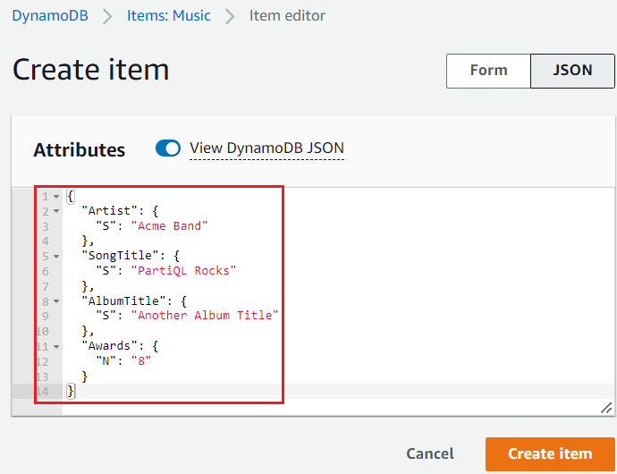
DynamoDB Service
Create item
UI
JSON

Slide 8
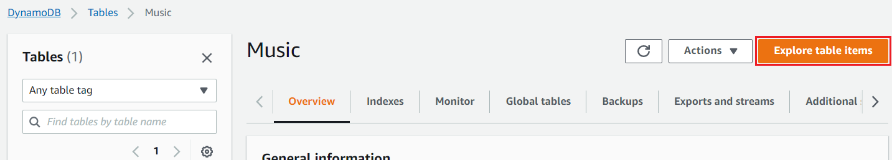
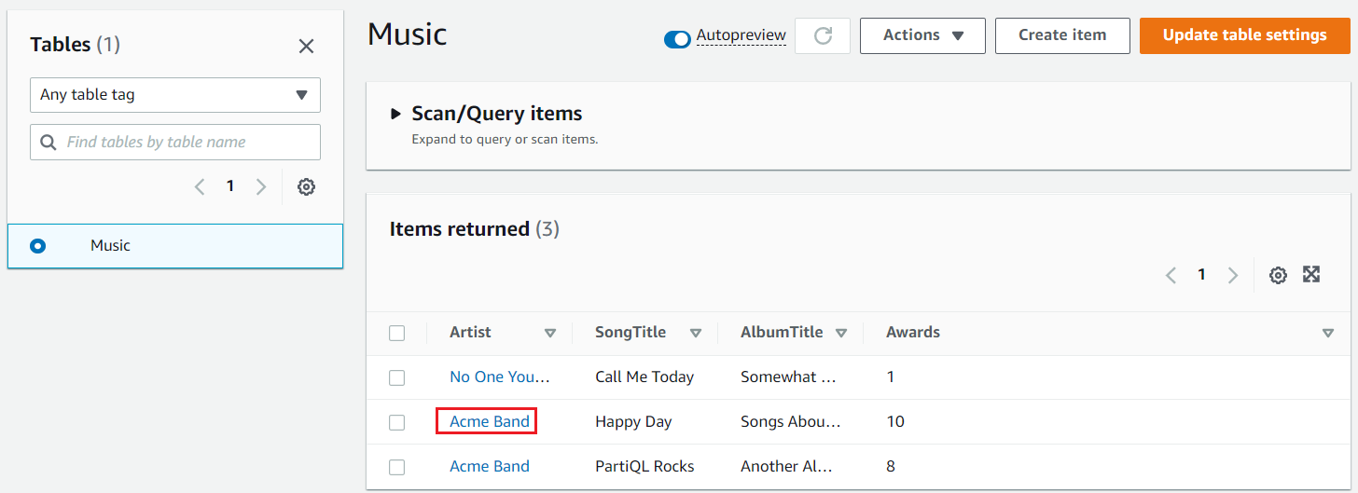
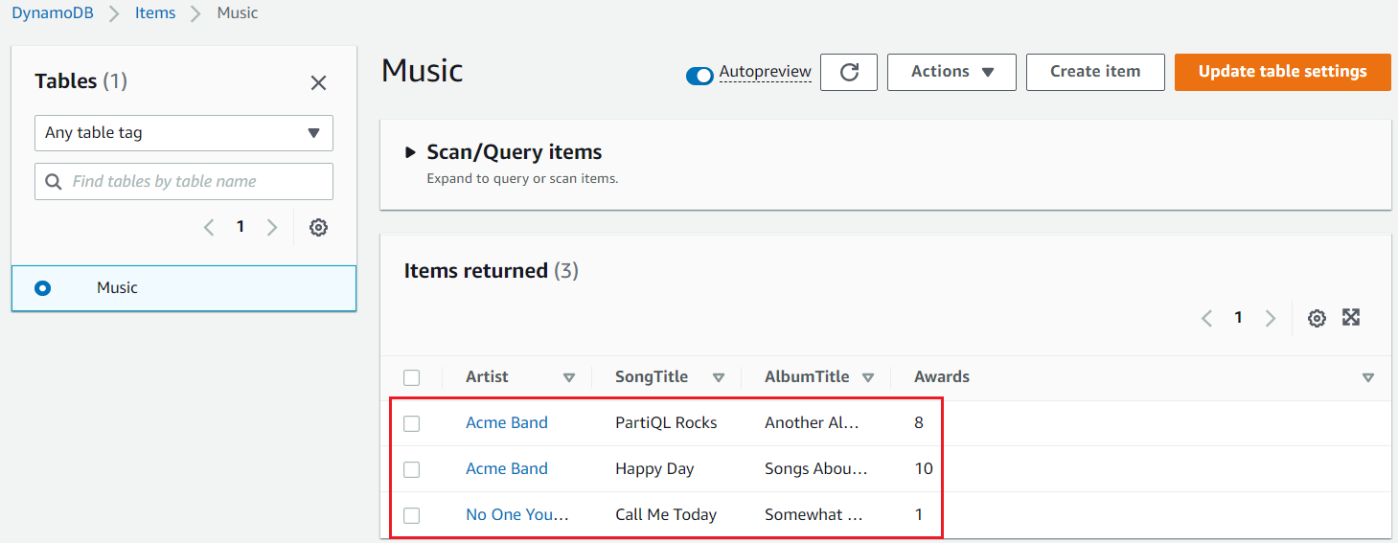
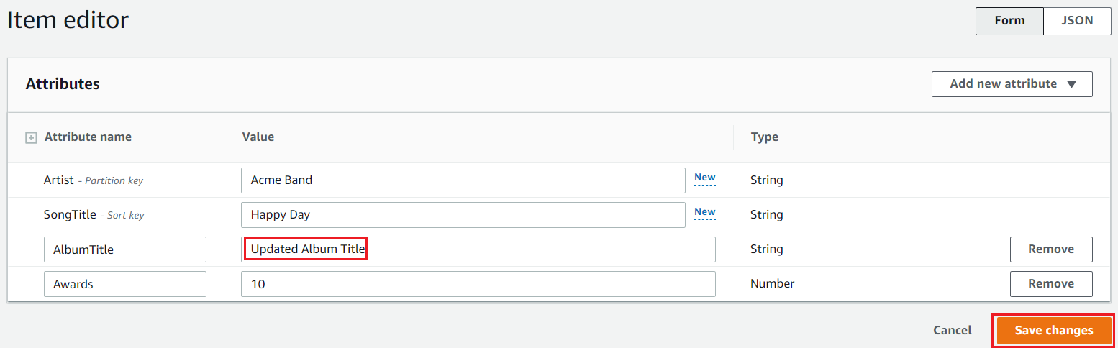
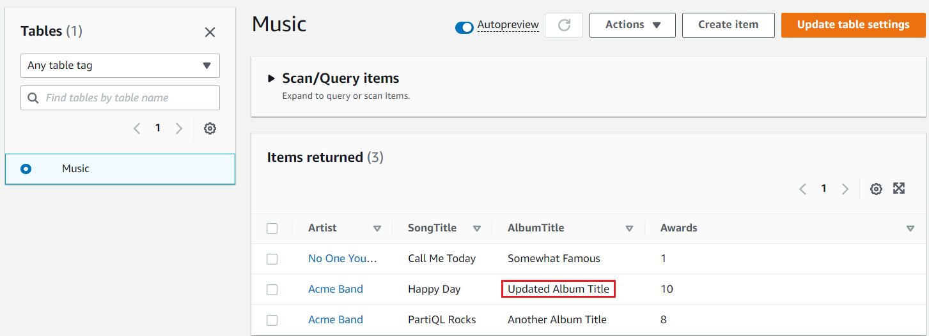
DynamoDB Service
View item
Update item
Sorted by Artist and SongTitle

Slide 9
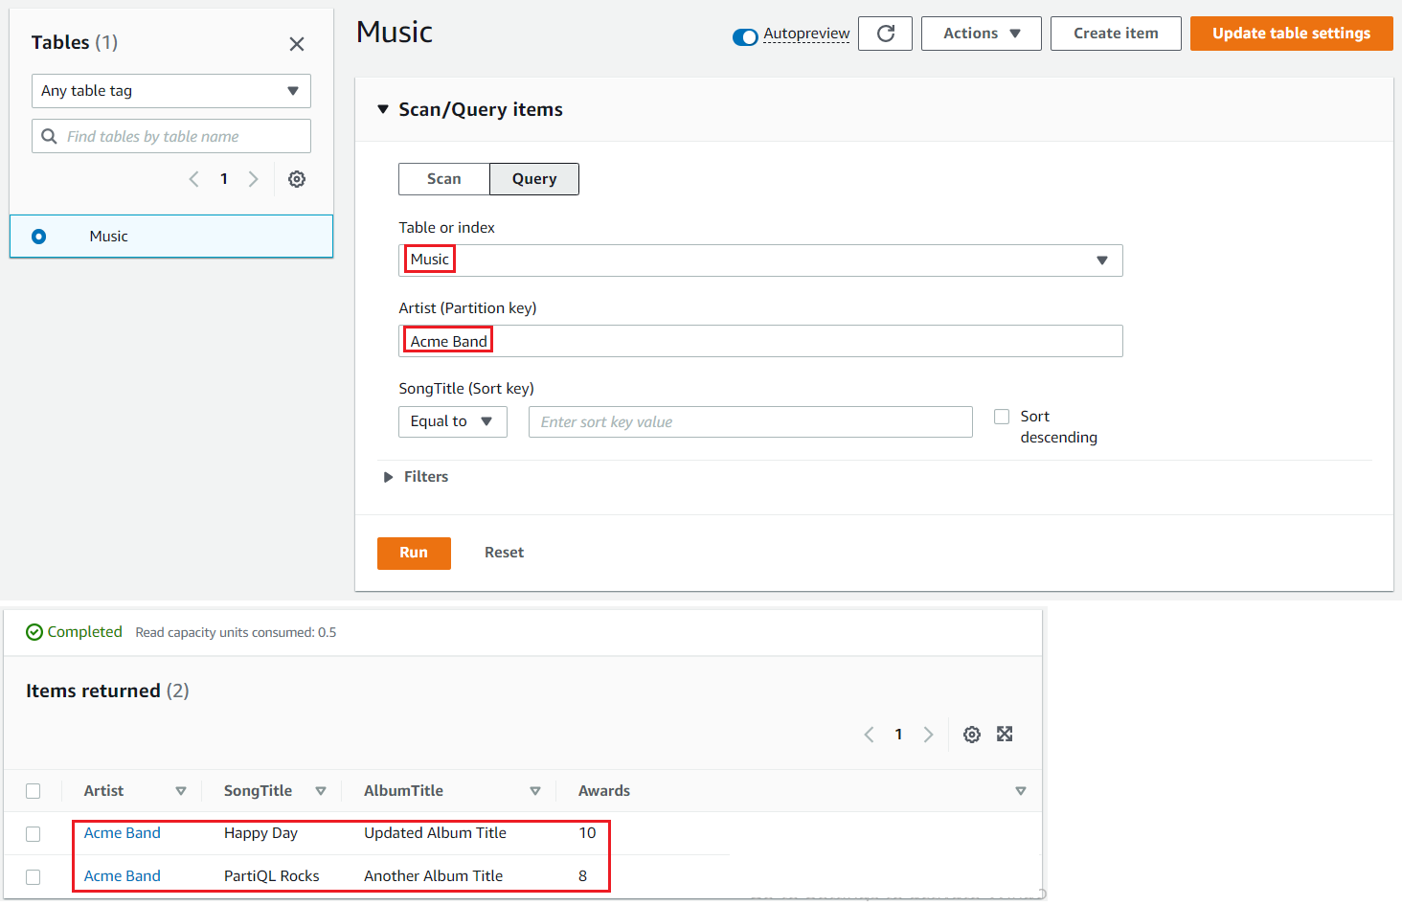
DynamoDB Service
Query the Partition Key & Sort Key
Get all songs that are associated with the partition key: Artist

Slide 10
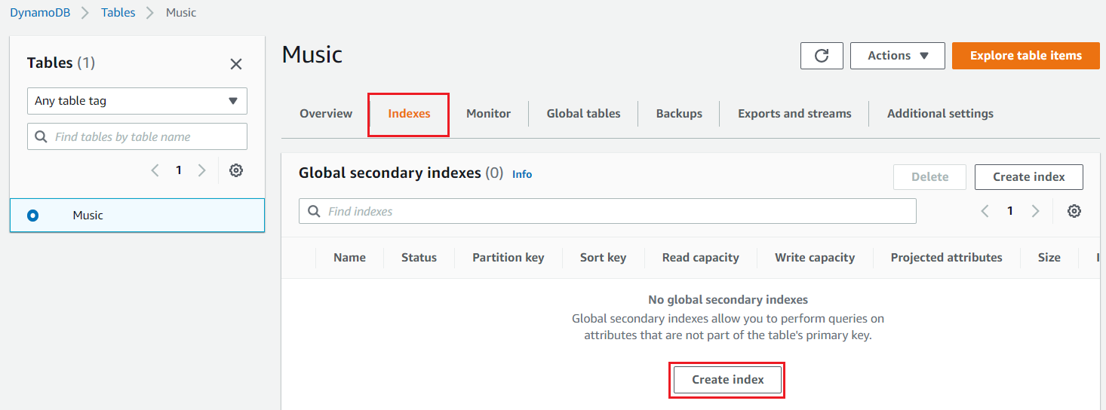
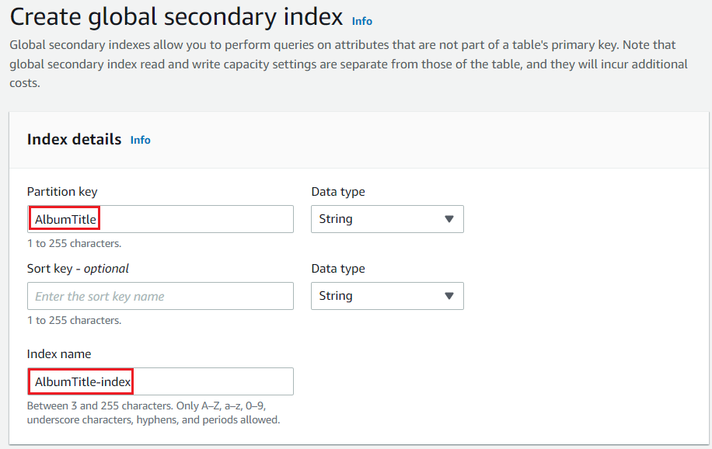
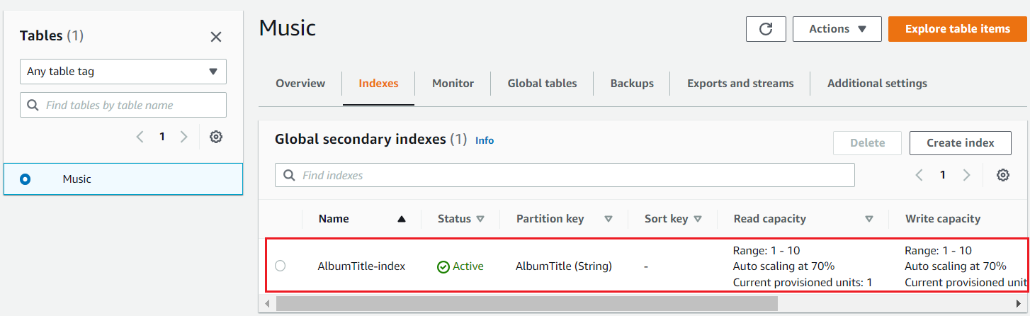
DynamoDB Service
Create Global Secondary Index

Slide 11
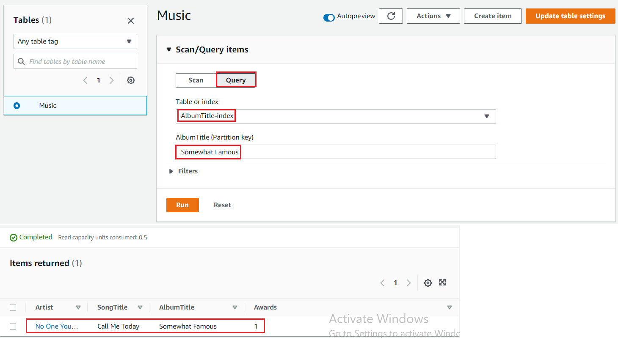
DynamoDB Service
Query the Global Secondary Index

Slide 12
Assignment
Self-practice

Slide 13
DynamoDB Service
Components
Table
Item
Partition key & Sort key
Secondary index
Query/Scan/PartiQL

Slide 14
DynamoDB Service
Table
DynamoDB is made of Tables
Each table has a Primary Key
Infinite number of items (rows)
Item (Row)
Including: list of attributes
Data types supported
Scalar Types: String, Number, Binary, Boolean, Null
Document Types: List, Map
Set Types: String Set, Number Set, Binary Set
Maximum size of an item is 400KB

Slide 15
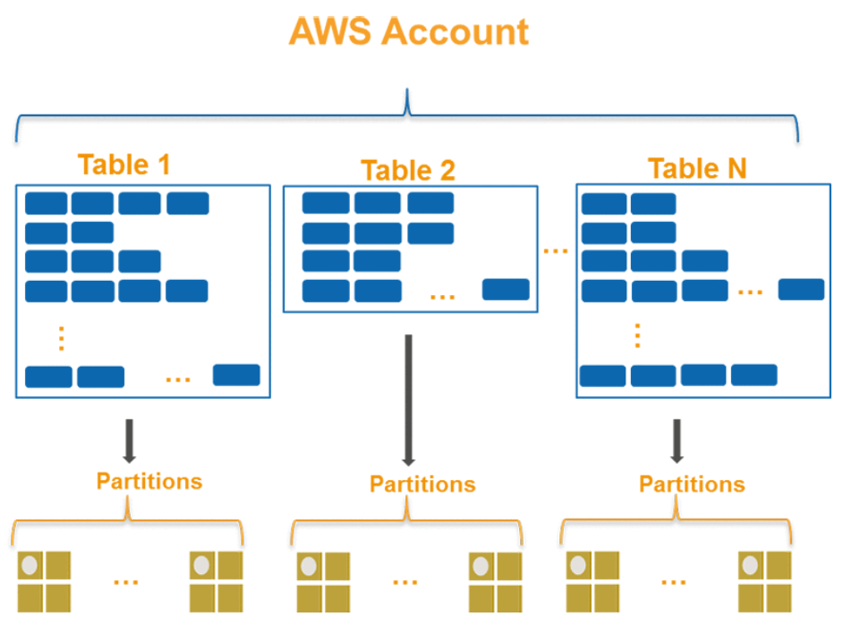
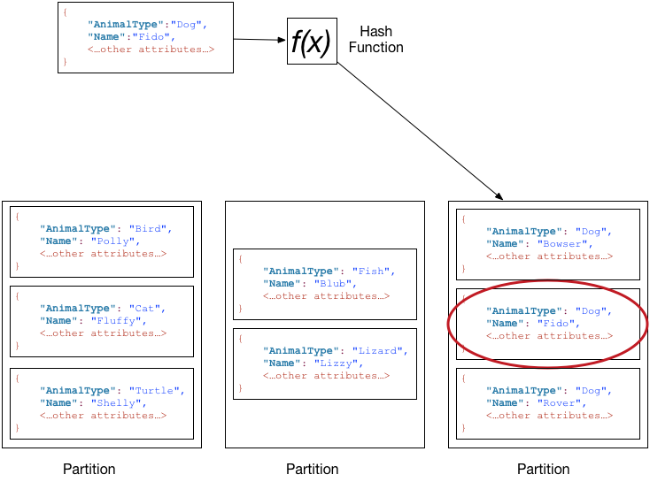
DynamoDB Service
Partition key & Sort key
DynamoDB stores data as groups of items
Items are distributed across 10-GB storage units, called partitions (physical storage internal to DynamoDB)
Each table has one or more partitions
DynamoDB supports two types of primary keys:
Partition key (Similar to primary key in RDS)
Partition key & Sort key (composite primary key)

Slide 16
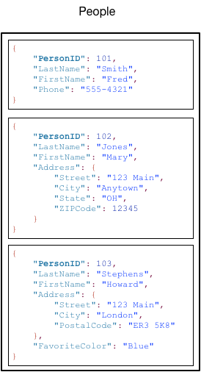
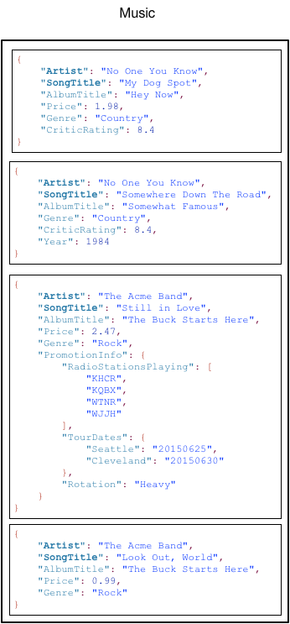
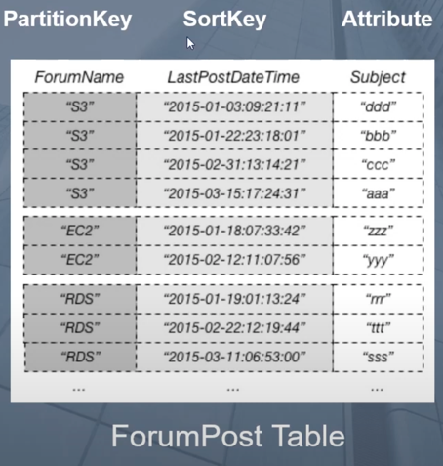
DynamoDB Service
Partition key
Similar to primary key, but items can be the same
In a table that has only a partition key
Sort key
Sort or search for items with the same Partition key
Partition key - PersonID
Partition key - Artist
Sort key - SongTitle
Tutorial: Link

Slide 17
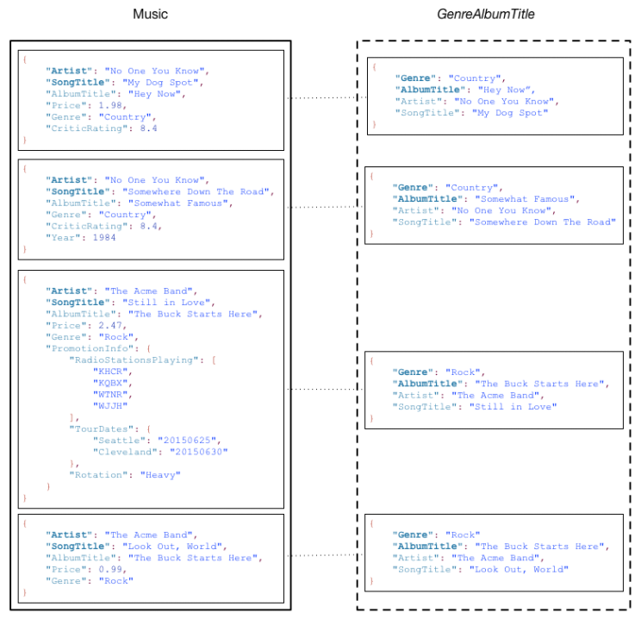
DynamoDB Service
Secondary index
Lets you query the data in the table using an alternate key, in addition to queries against the primary key
Data Synchronization Between Tables and Indexes
Can create multiple indexes
Partition key - Artist
Sort key - SongTitle
GenreAlbumTitle Index

Slide 18
DynamoDB Service
2 types:
Local secondary index (LSI)
An index that has the same partition key as the table, but a different sort key
Ex: You could have an Order History table with a Partition key of customer id, a Sort key of order date, and a secondary index range key on order destination city. You can use a Local Secondary Index to find all orders delivered to a particular city using a simple query for a given customer id.
Global secondary index (GSI)
An index with a partition key and sort key that can be different from those on the table
Ex: In the Order History table example, you can create a global index on zip code, so that you can find all orders delivered to a particular zip code across all customers. Global Secondary Indexes allow you to retrieve items based on any desired attribute.
https://docs.aws.amazon.com/amazondynamodb/latest/developerguide/HowItWorks.CoreComponents.html#HowItWorks.CoreComponents.SecondaryIndexes

Slide 19
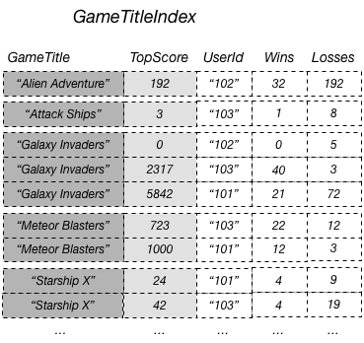
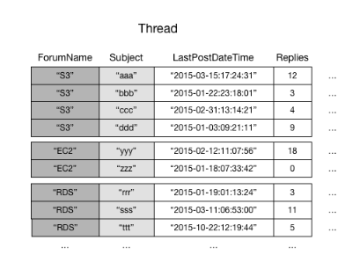
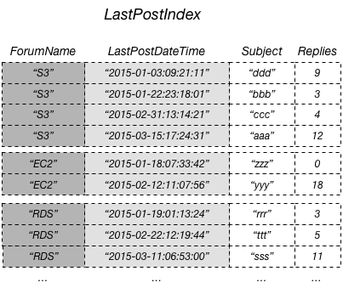
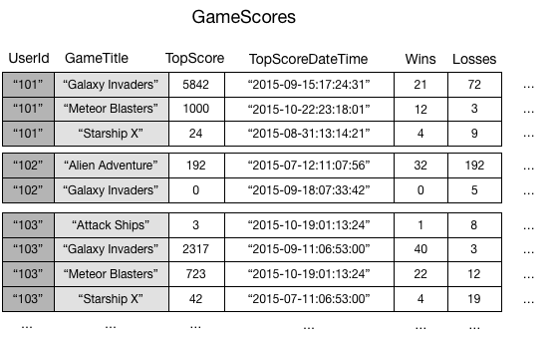
DynamoDB Service
Example
Base table
Global Secondary Index
Base table
Local Secondary Index
https://docs.aws.amazon.com/amazondynamodb/latest/developerguide/GSI.html
https://docs.aws.amazon.com/amazondynamodb/latest/developerguide/LSI.html

Slide 20
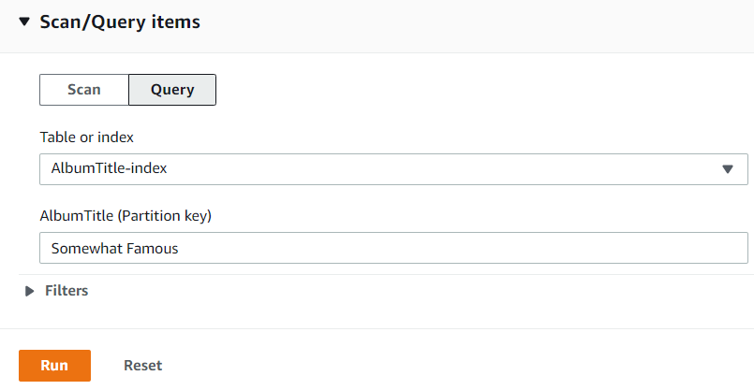
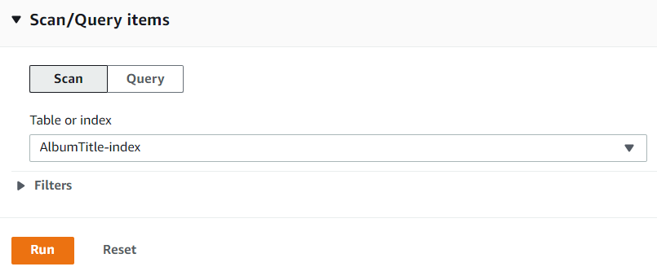
DynamoDB Service
Query
Query items based on Partition Key & Sort Key (Table or Secondary Index)
Support sort, filter, paging, count, ...
Scan
Reads every item in table or secondary index
Maximum of 1 MB
Support sort, filter, paging, count, ...
Query
Scan

Slide 21
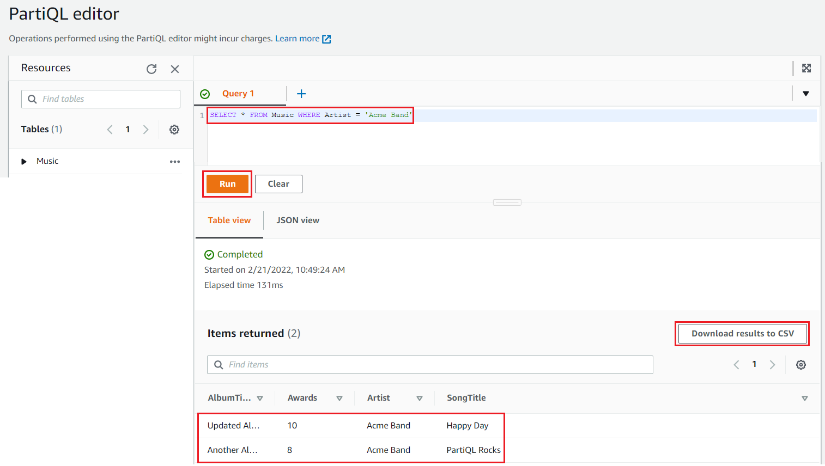
DynamoDB Service
PartiQL
Query items with SQL syntax
Support
Select(where, orderby, subquery)
Insert, Update, Delete
Transaction
Export to CSV file

Slide 22
Assignment
Self-practice

Slide 23
DynamoDB Service
Settings for Table/Secondary index
Table class
Read/write Consistency
Read/write capacity mode
Conditional writes
Expiring Items by Time to Live
Encryption
Backup – Restore
Monitoring

Slide 24
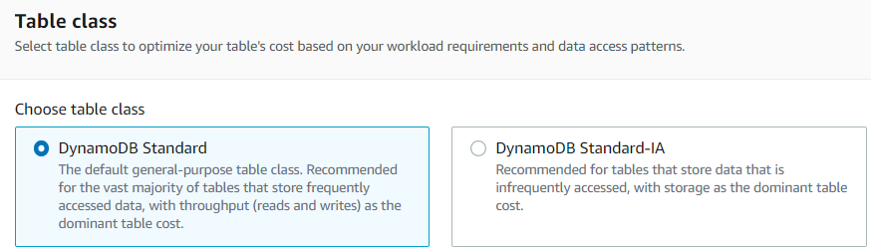
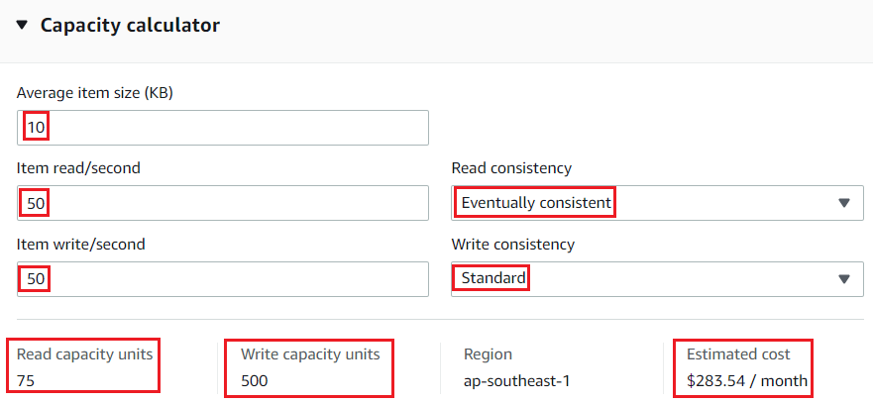
DynamoDB Service
Table class
Support Standard, Standard-IA
Capacity unit
Is the unit of measurement of request volume of requests to access the DB
2 types
Read capacity unit (RCU)
Write capacity unit (WCU)

Slide 25
DynamoDB Service
Read Consistency
Eventual Consistent (Default)
Since data is replicated between zones 🡺 you can get old data
Strongly Consistent
Make sure to always read the latest data, higher price
Transactional
Write Consistency
Standard
Transactional

Slide 26
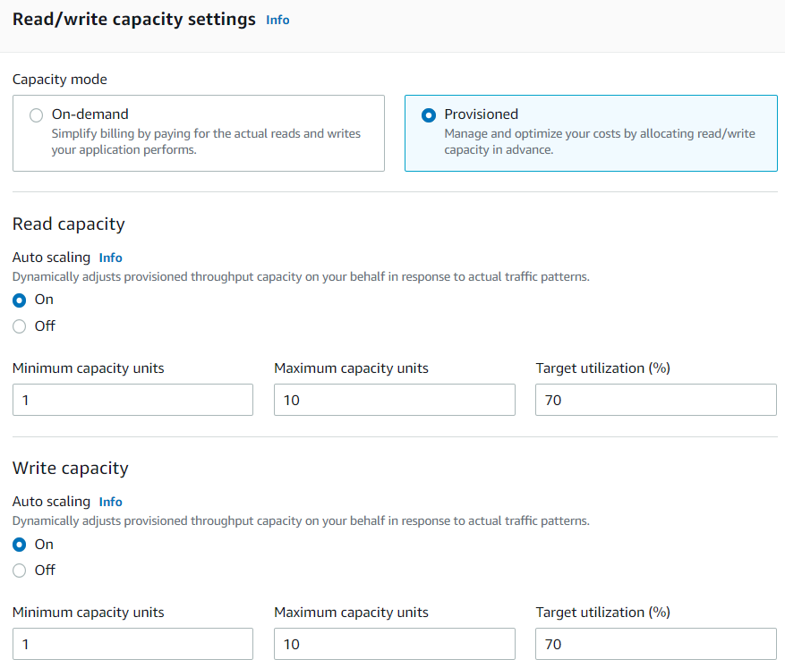
DynamoDB Service
Read/write capacity mode
On-demand
Pay based on read/write capacity
Auto scaling based on workload
Provisioned (Default)
Fix read/write capacity unit
Auto scaling based on workload

Slide 27
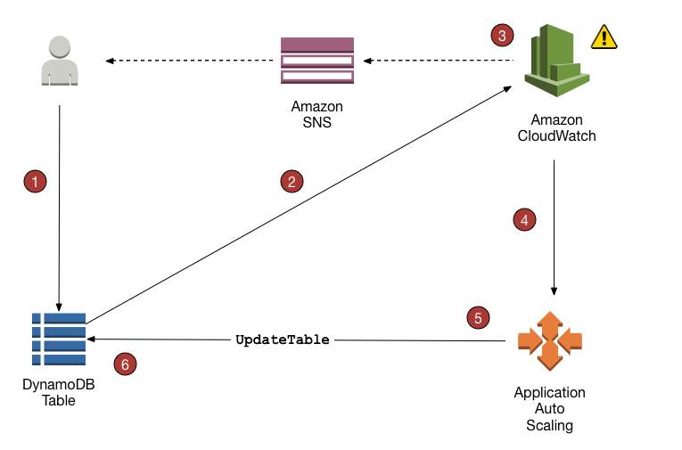
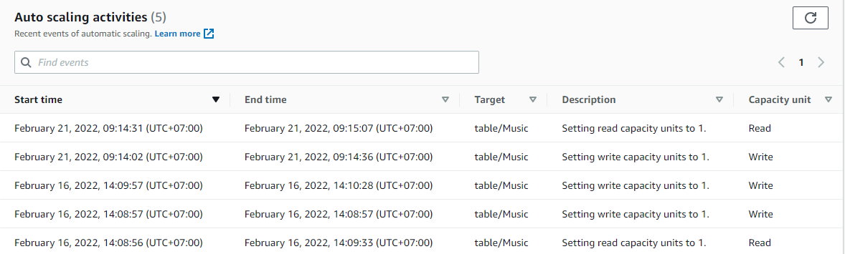
DynamoDB Service
Auto scaling capacity

Slide 28
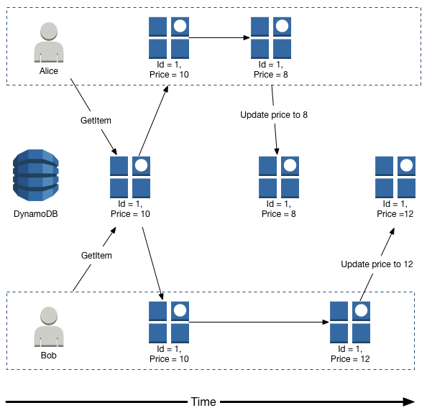
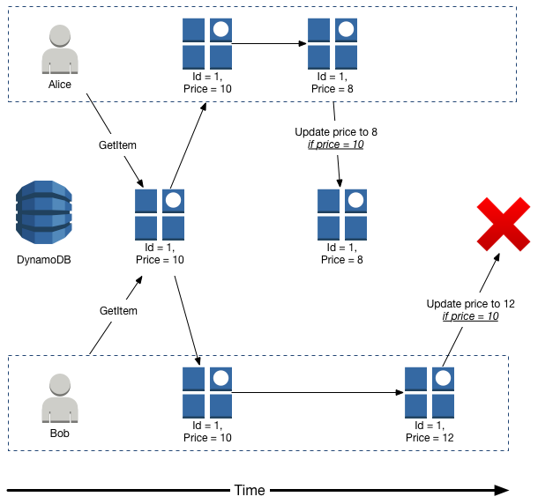
DynamoDB Service
Conditional writes
Check condition when an item is updated by many requests

Slide 29
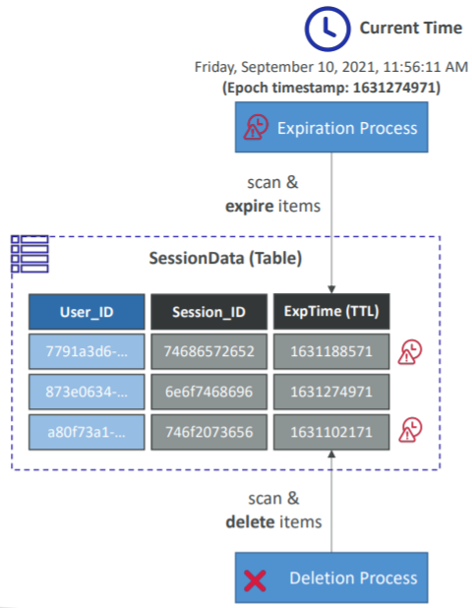
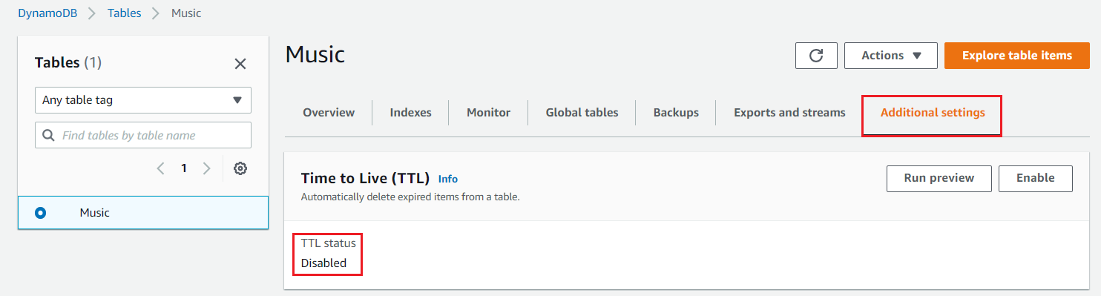
DynamoDB Service
Expiring Items By Time to Live
Automatically delete expired items from a table

Slide 30
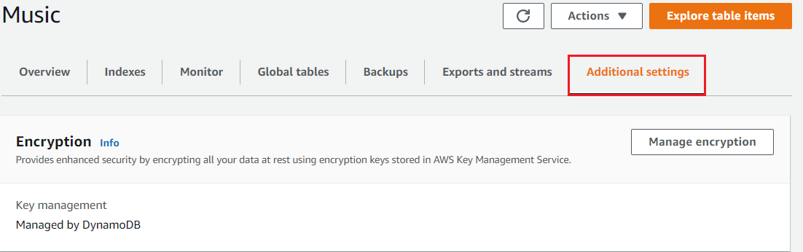
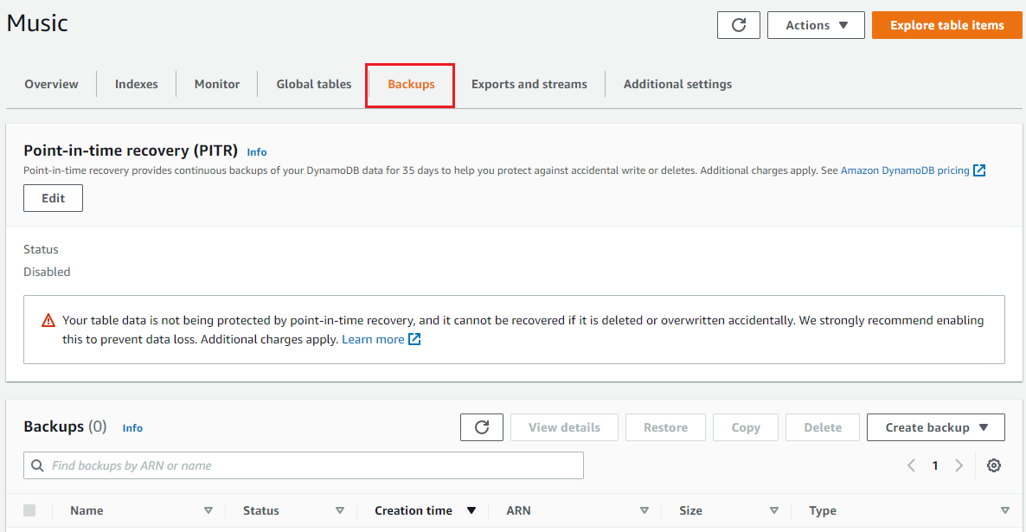
DynamoDB Service
Encryption
DynamoDB does not encrypt each item in the table 🡺 you must use client-side library to encrypt items before saving
Backup - Restore
On-demand backup: manual snapshot
Enable Point-in-Time Recovery (PITR): automatic snapshot
Support export to S3
Monitoring
Monitoring via CloudWatch, create alarm

Slide 31
Assignment
Self-practice

Slide 32
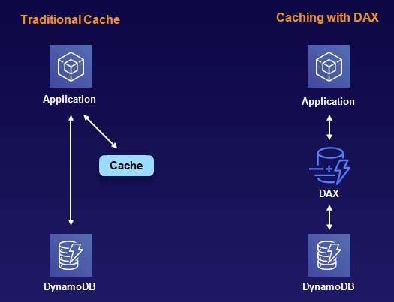
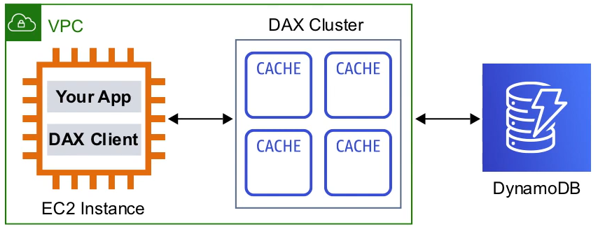
DynamoDB Service
DynamoDB Accelerator (DAX)
In-memory cache for DynamoDB & Application, help increase performance
Support reading request
Microseconds latency for cached data
Support IAM role to allow DAX cluster to read/write DynamoDB

Slide 33
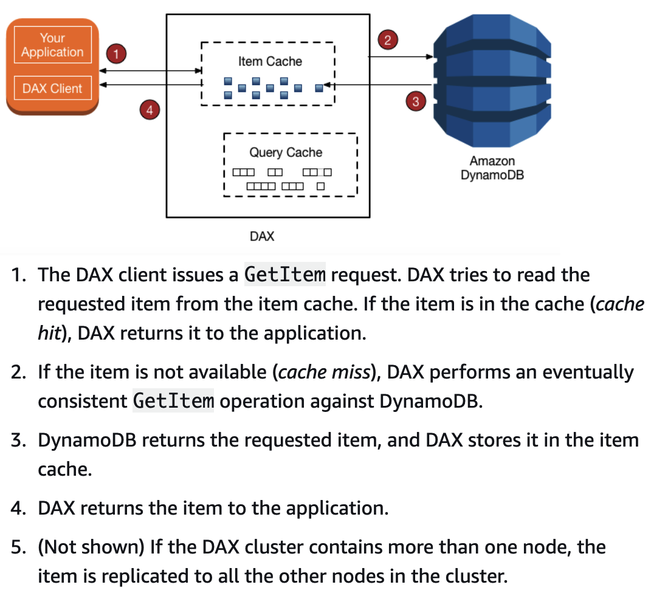
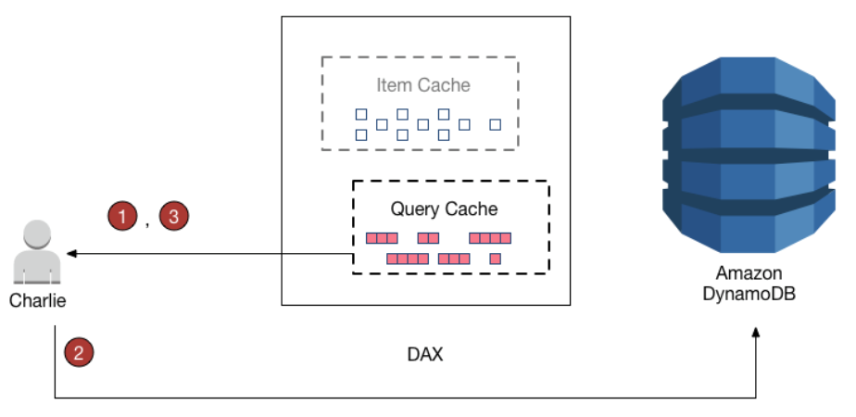
DynamoDB Service
Support item cache, query cache
Query cache
Item cache

Slide 34
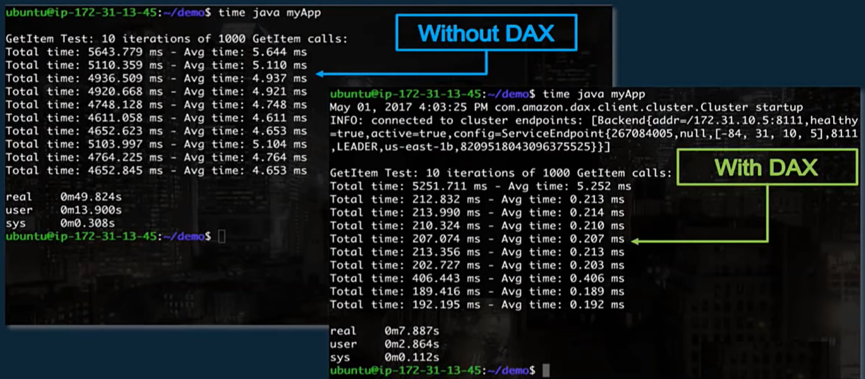
DynamoDB Service
Performance

Slide 35
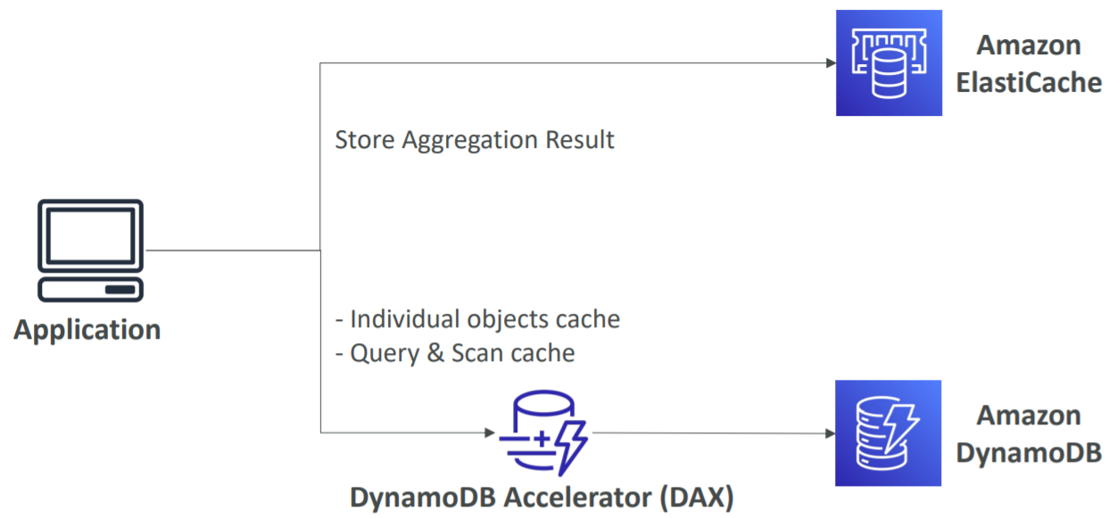
DynamoDB Service
Comparing DAX & ElastiCache

Slide 36

DynamoDB Service
Setup
https://www.youtube.com/watch?v=ZMkLhD8OxYQ
https://www.youtube.com/watch?v=sphOT_e4WJ8

Slide 37

DynamoDB Service
DynamoDB Stream
Using for streaming data
Item-level
Data Retention for up to 24 hours
Usecases
Application with thousands of updates per second
Stock Application
Log real-time changes in database

Slide 38

DynamoDB Service

Slide 39


DynamoDB Service
Global tables
Make a DynamoDB table accessible with low latency in multiple-regions
Applications can READ and WRITE to the table in any region (Two-way replication)
Must enable DynamoDB Streams
Not support Strongly Consistent
Tutorial: https://www.youtube.com/watch?v=a5foTVaAkqg

Slide 40
Assignment
Self-practice

Slide 41
Summary
Is a NoSQL database, a proprietary technology from AWS
Millions of requests per seconds, trillions of row, hundreds of TB for storage
Auto scaling based on massive workloads, distributed database
Usecase: e-commerce application, storing session state
Components: Table, Item, Partition key & Sort key, Secondary index

Slide 42
Summary
Settings
Table class: Standard/Standard-IA
Read/write Consistency: Eventual Consistent/Strongly Consistent
Read/write capacity mode: On-demand/Provisioned
Conditional writes
Expiring Items by Time to Live
Encryption: only support client-side
Backup - Restore: On-demand backup/Enable Point-in-Time Recovery (PITR)
Monitoring: CloudWatch, create alarm

Slide 43
Summary
DynamoDB Accelerator (DAX)
In-memory cache for DynamoDB & Application, help increase performance
Support IAM role to allow DAX cluster to read/write DynamoDB
Support item cache, query cache
DynamoDB Stream: using for streaming data, Retention for up to 24 hours
Regional service, support global table (Two-way replication)

Slide 44
Assignment

Slide 45
Quiz

Slide 46
Reference
https://docs.aws.amazon.com/

Slide 47
Q & A
Copyright © VTI Academy All Rights Reserved

